Slide 1
Adapter and Facade Pattern
Structural Design Pattern
P-273

Slide 2
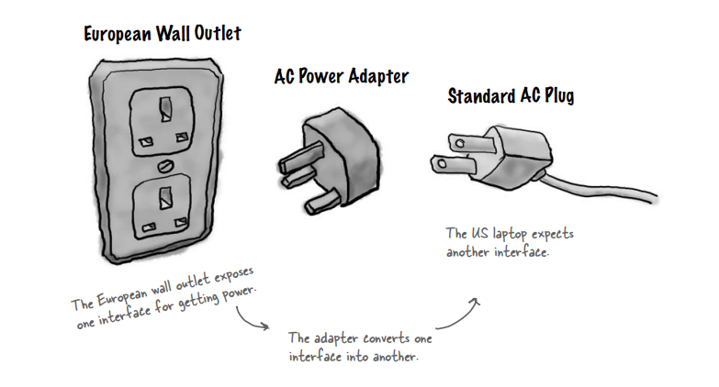

Slide 3
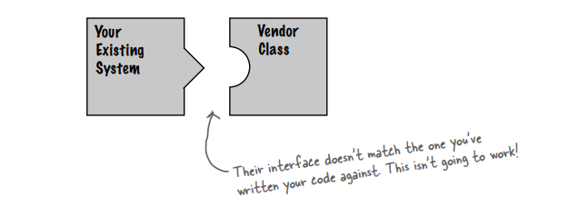
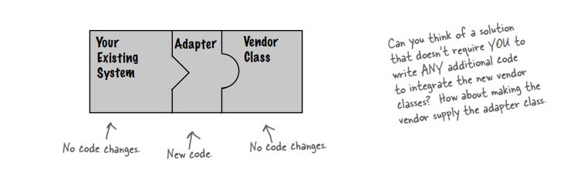
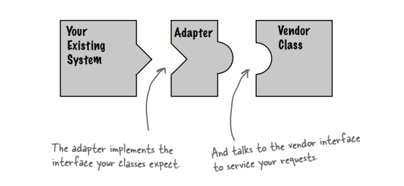
Object oriented adapters

Slide 4
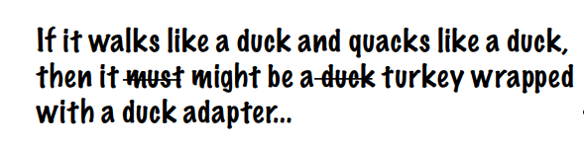
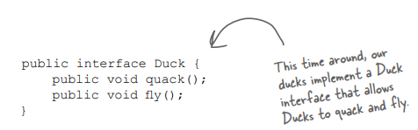
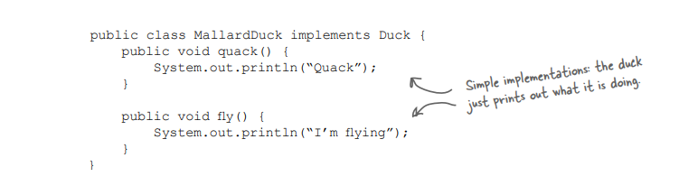
Previously in Chapter 1

Slide 5
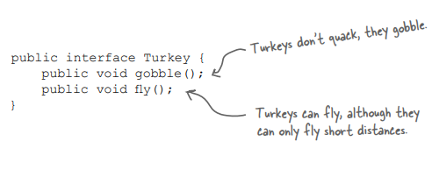
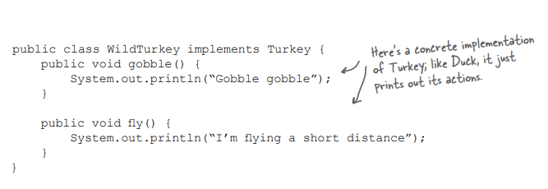
Now, we have new Turkey Interface and concrete class implementation

Slide 6
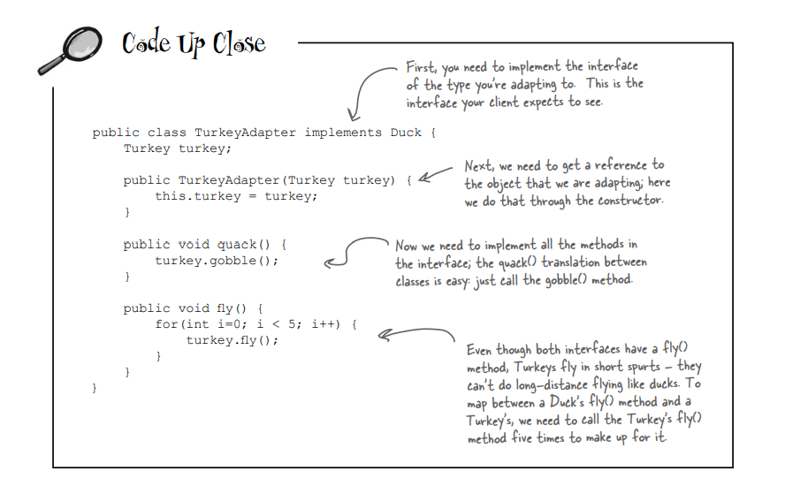
Adapter

Slide 7
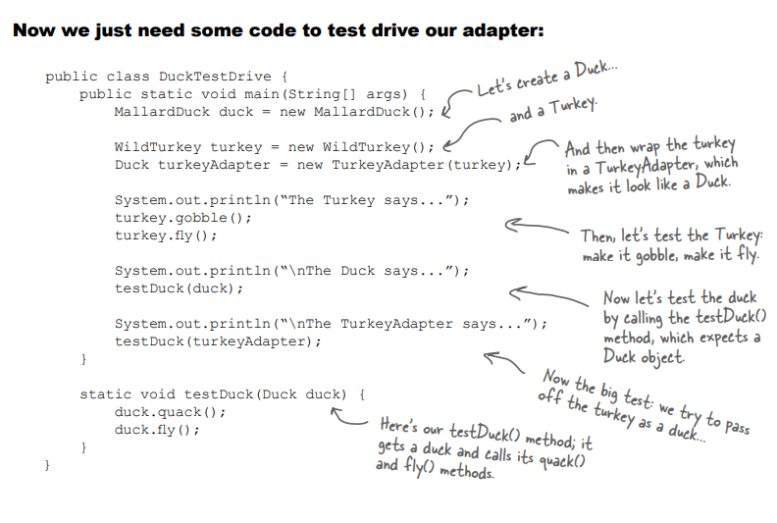

Slide 8
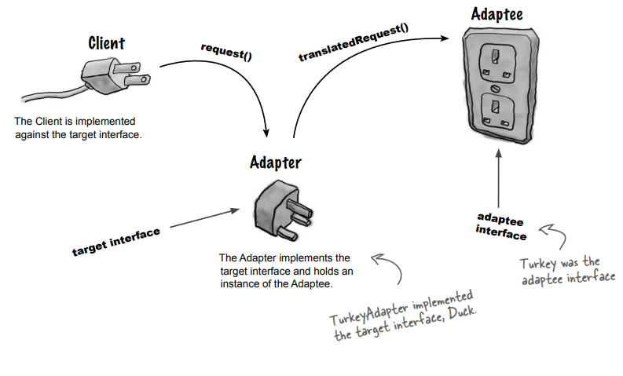
The Adapter Pattern explained

Slide 9
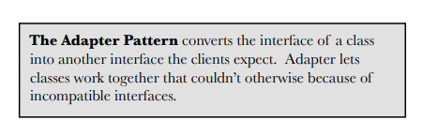
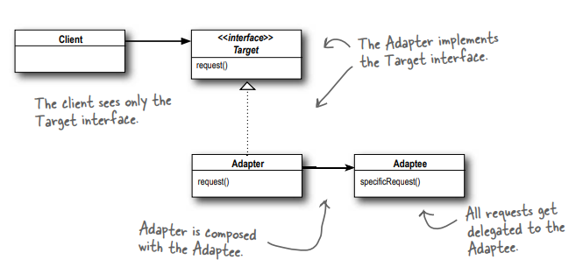
Adapter Pattern defined

Slide 10
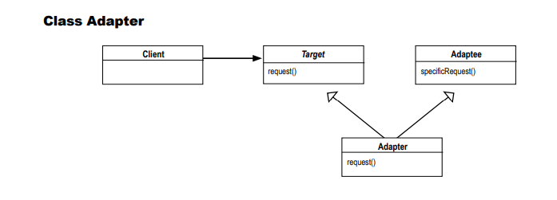
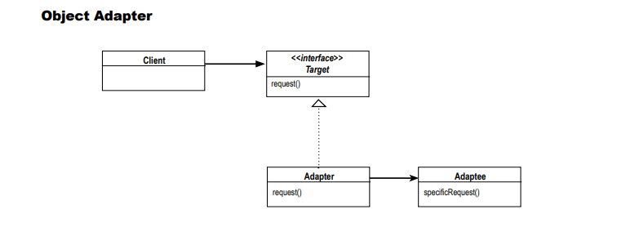
Class Adapter vs Object Adapter

Slide 11
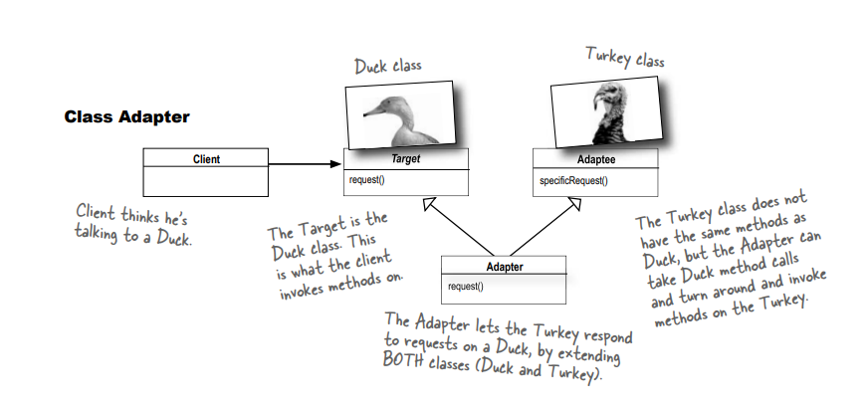
Adapting classes

Slide 12
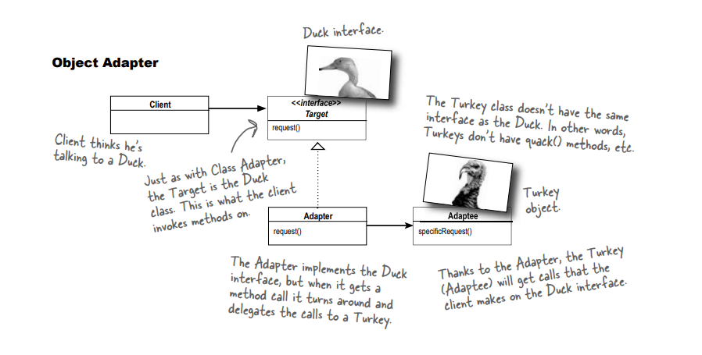

Slide 13
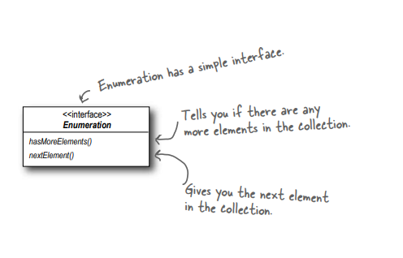
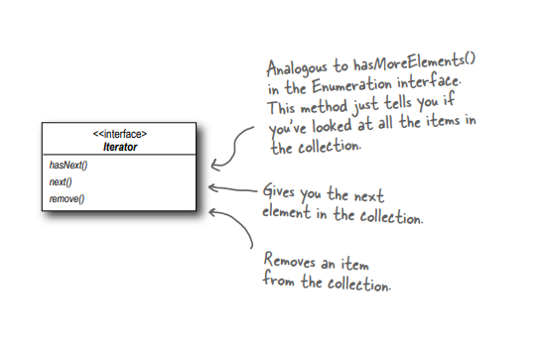
Real World Adapters
New world Iterators
Old world Enumerators

Slide 14
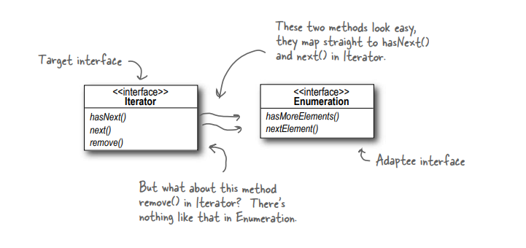
Adapting an Enumeration to an Iterator
Make something to mimic the behaviour of Target using the behaviour of Adaptee

Slide 15
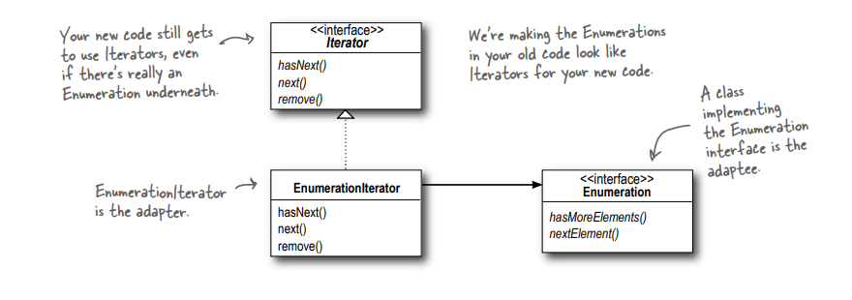
Designing the Adapter

Slide 16
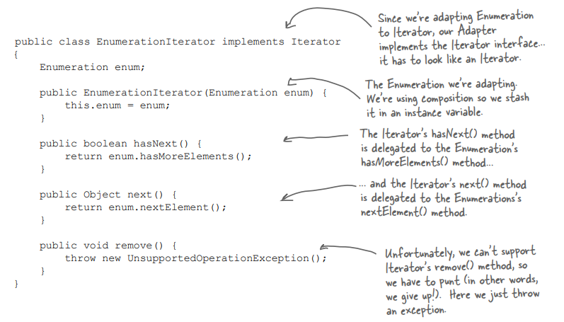
Writing the EnumerationIterator adapter
Adaptee has no function to implement this behavior, that’s why this exception lies there

Slide 17
Decorator
Adapter
Facade
Head to Head comparison among Decorator, Adapter and Facade Design Pattern
Doesn’t alter the interface, but adds responsibility
Converts one interface to another
Makes an interface simpler

Slide 18
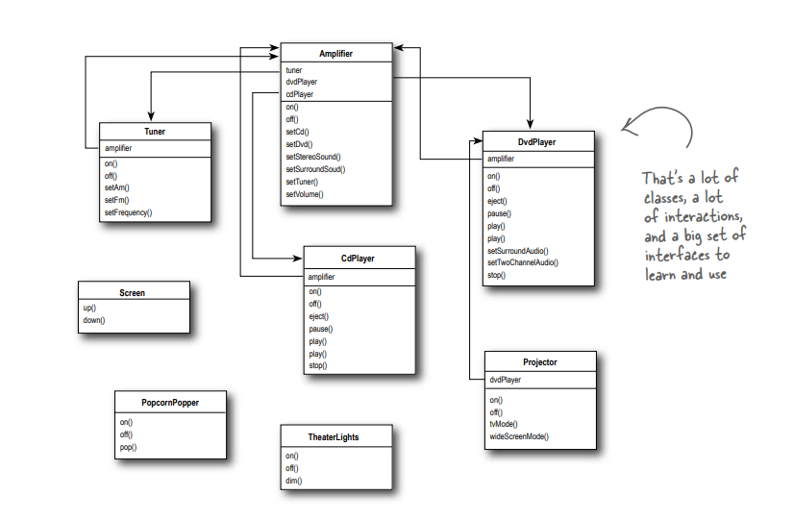
Home Sweet Home Theater

Slide 19
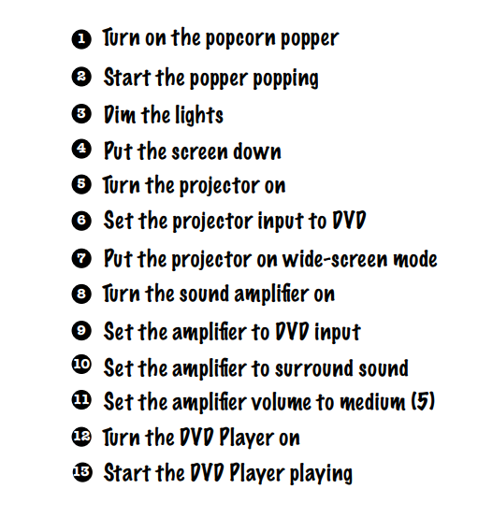
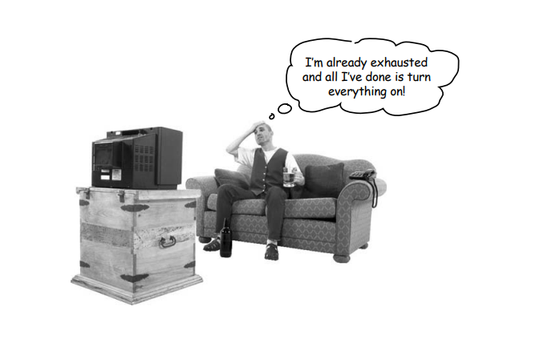
Watching a movie (the hard way

Slide 20
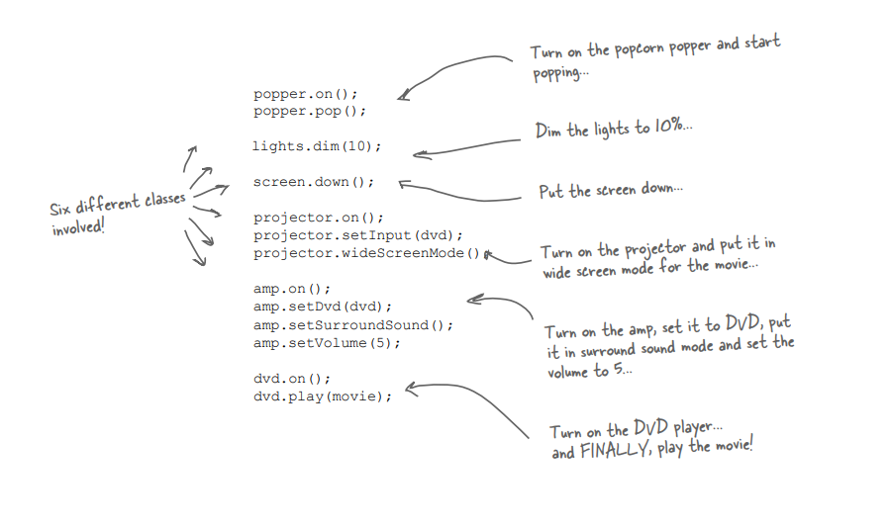
But not limited to

Slide 21
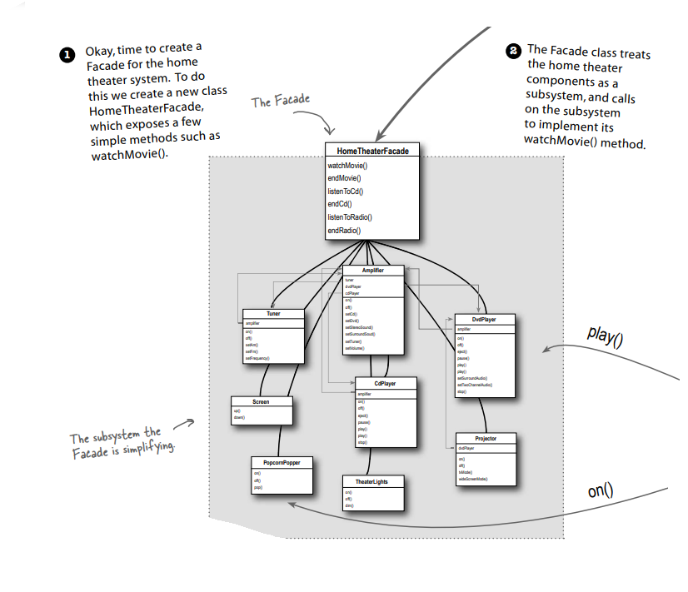
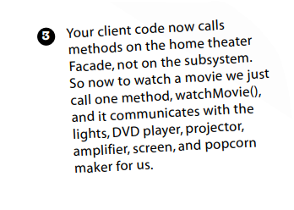
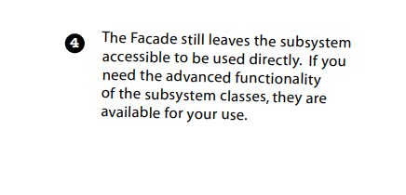
Light, Camera, Facade!

Slide 22
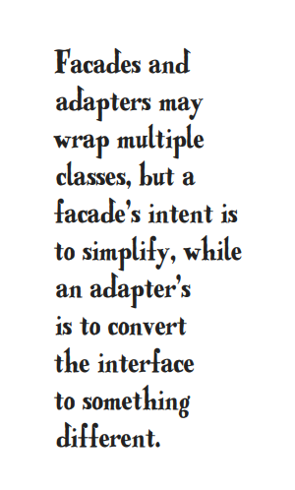
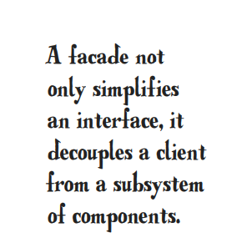

Slide 23
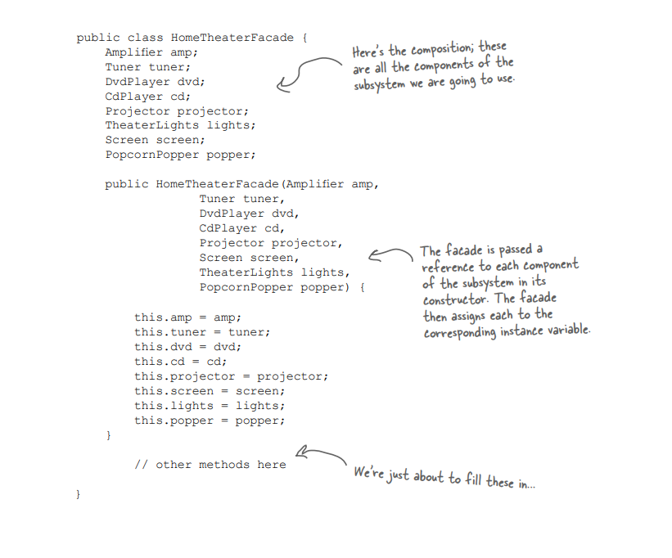
Constructing your home theater facade
Composition
The habit of storing references of different classes !!!

Slide 24
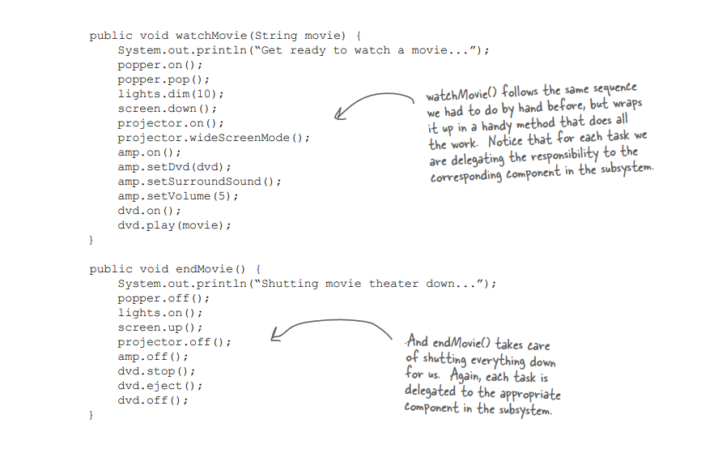
Implementing the simplified interface
Single component single responsibility

Slide 25
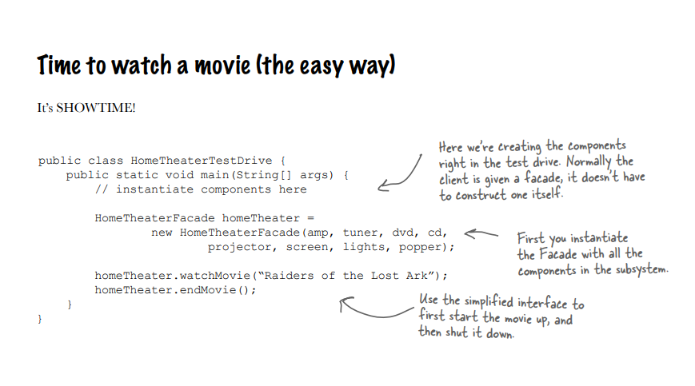

Slide 26
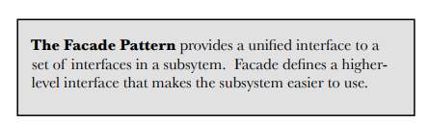
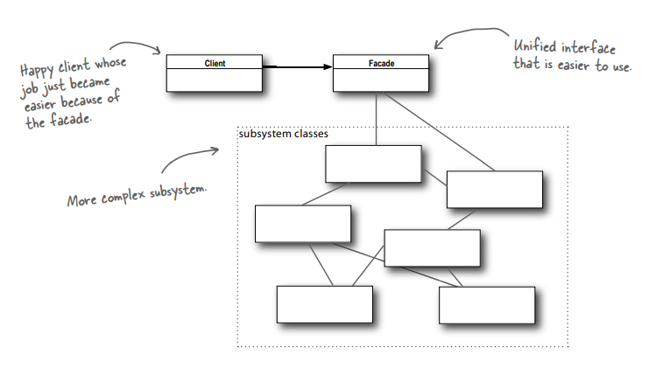
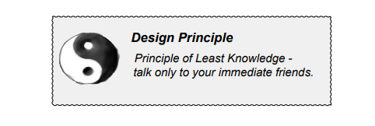
Summary of Facade Pattern

Slide 27
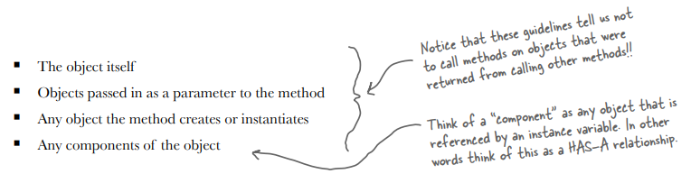
Application on the Principle of Least Knowledge
Among an object O of a class, which object’s functions should be invoked.

Slide 28
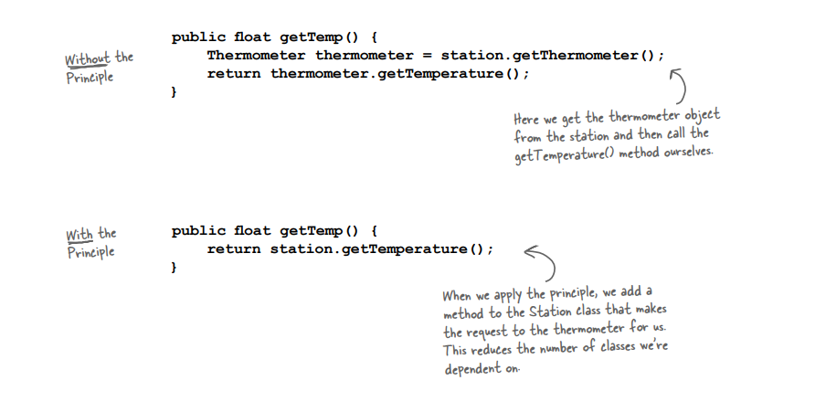
The Principle of Least Knowledge

Slide 29
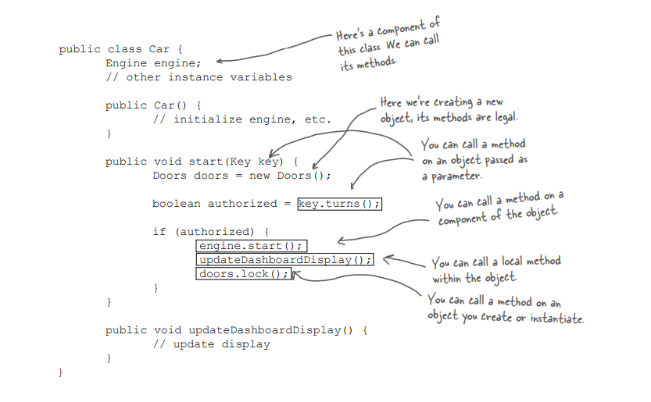

Slide 30
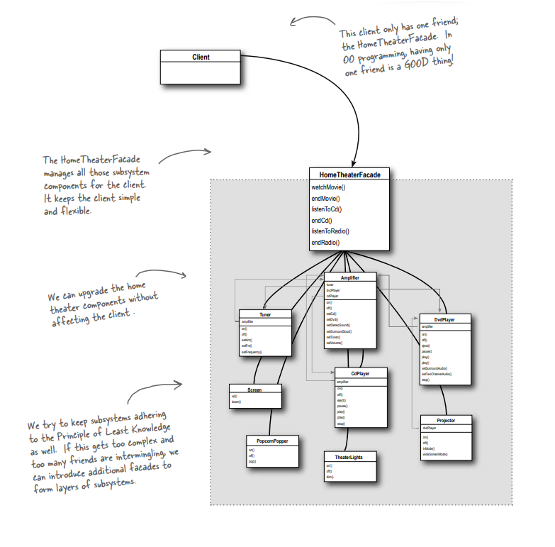
The Facade Design Pattern and The Principle of Least Knowledge

Slide 31
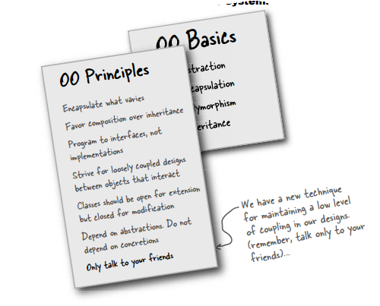
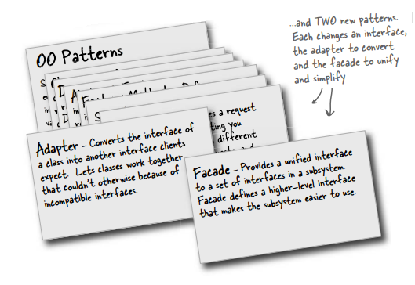
Summary

